Slide 1
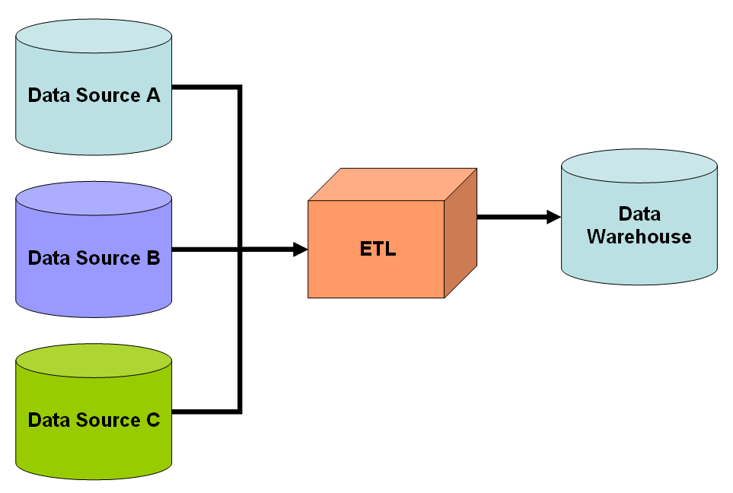
Data Warehousing and Data Mining Approach for TLC Taxi Data
By : Shruti Kant

Slide 2

Agenda:
Data Warehousing Overview
Google Cloud Platform for Data Warehousing
Data Marts Design
Data Mining Models
Multiple Linear Regression
Cluster Analysis
Visualizing Results
Key Insights and Next Steps

Slide 3
Overview of Data Warehousing:
What is a Data Warehouse?
Centralized repository for integrated data from multiple sources.
Optimized for analytics and reporting.
Why a Data Warehouse for TLC Data?
Enables advanced analytics on trip patterns and demand trends.
Platform Chosen: Google Cloud Platform (BigQuery).
Scalable, serverless, and easy-to-integrate with tools.

Slide 4
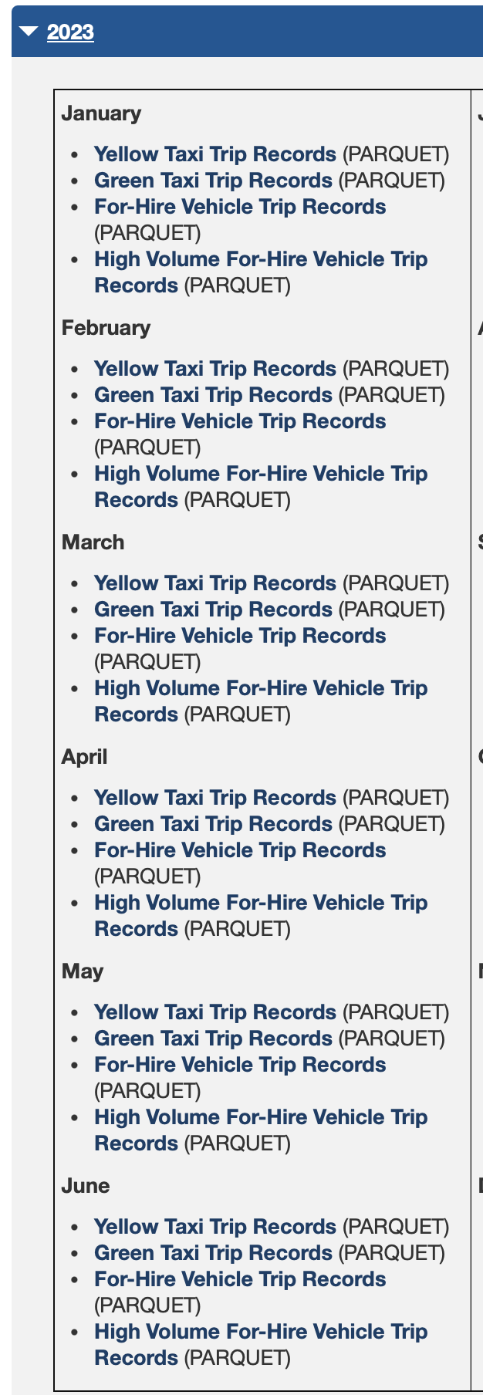
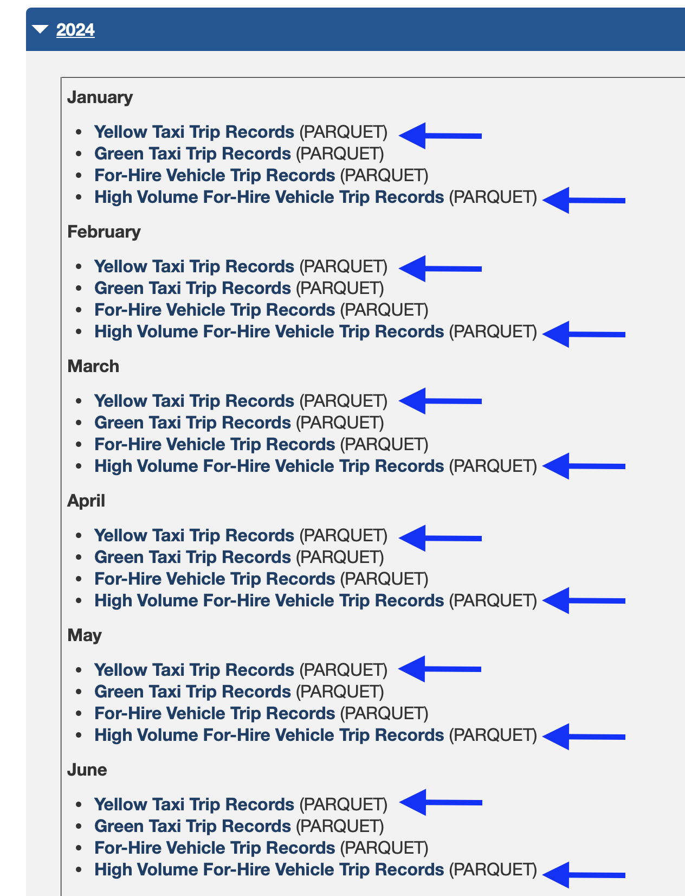
Download the files from : https://www.nyc.gov/site/tlc/about/tlc-trip-record-data.page

Slide 5
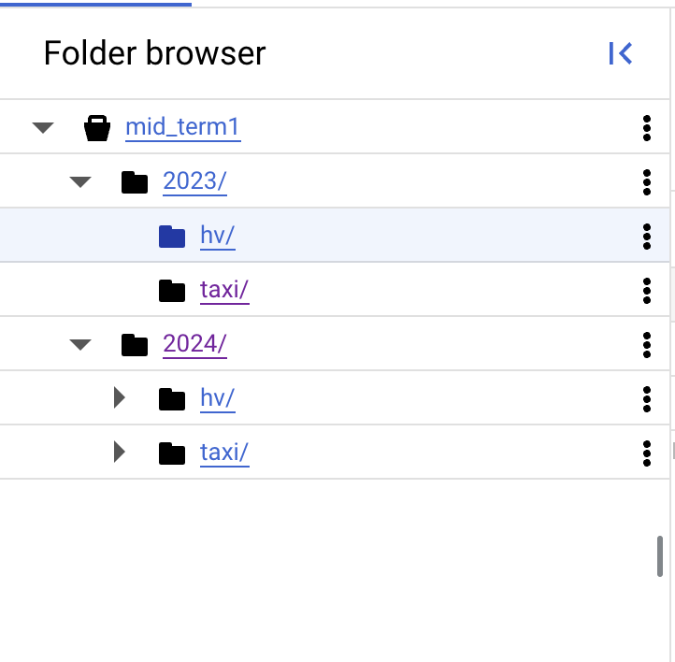
Cloud Storage Buckets
Bucket: Year2023
taxi
hv-fhv
Bucket: Year2024
taxi
hv-fhv

Slide 6
Data Warehouse Architecture
Data Sources:
Yellow Taxi Data (2023, 2024)
Uber and Lyft Data (High-Volume For-Hire Services)
ETL Process:
Extract: Raw data from CSVs and APIs.
Transform: Clean and enrich data (e.g., map borough names).
Load: Store in BigQuery for querying and analysis.
Central Repository: Google BigQuery

Slide 7
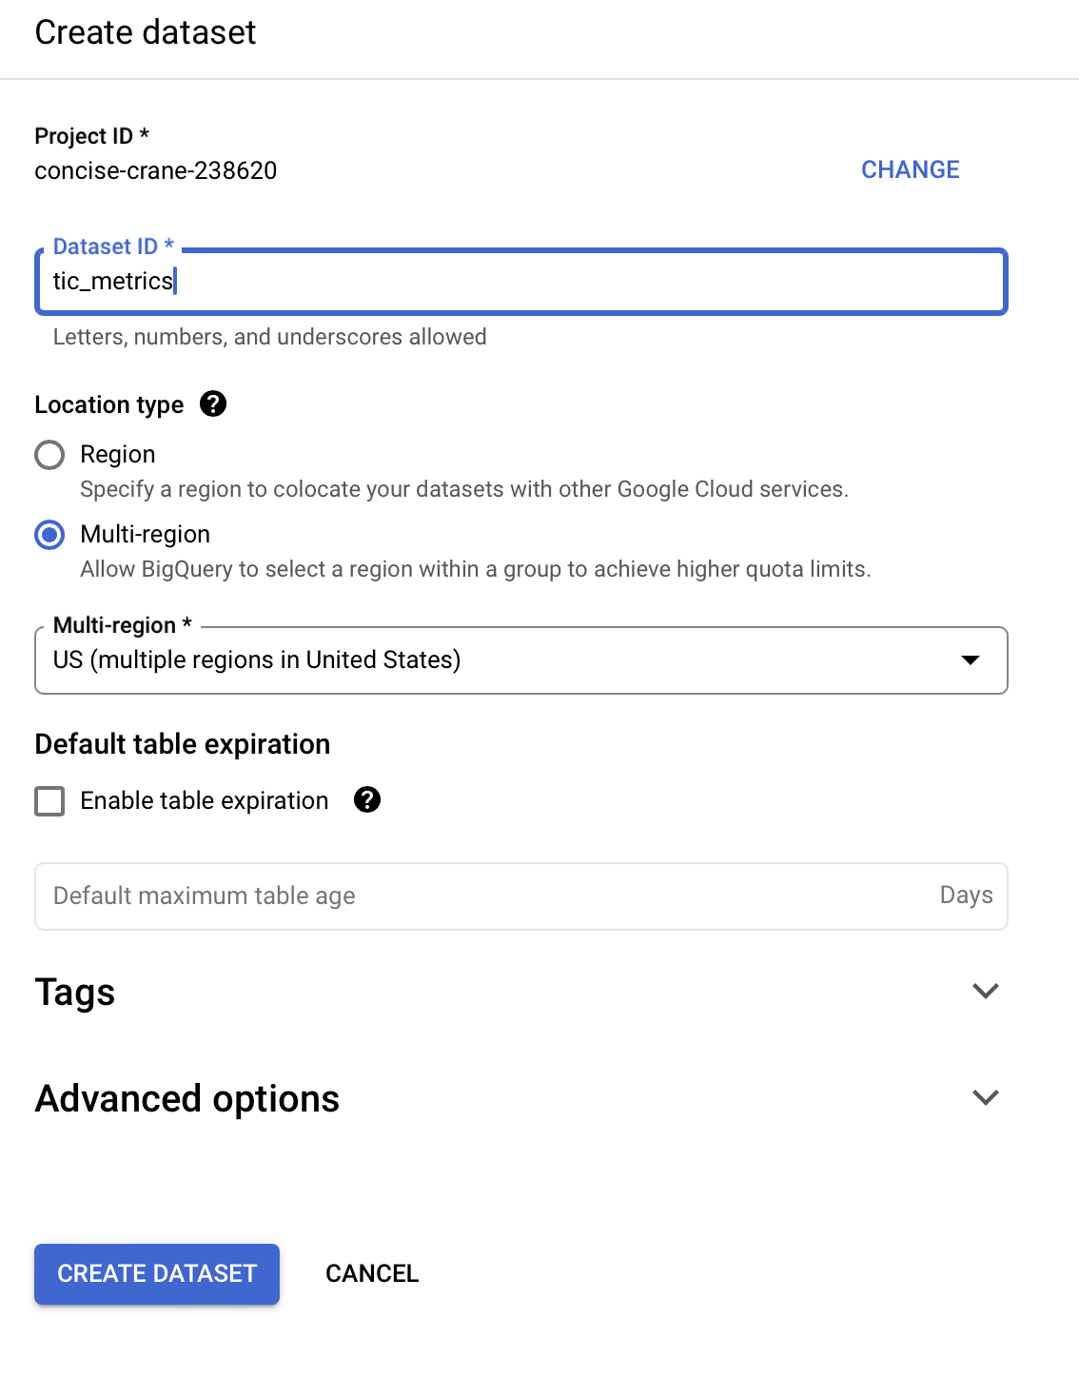
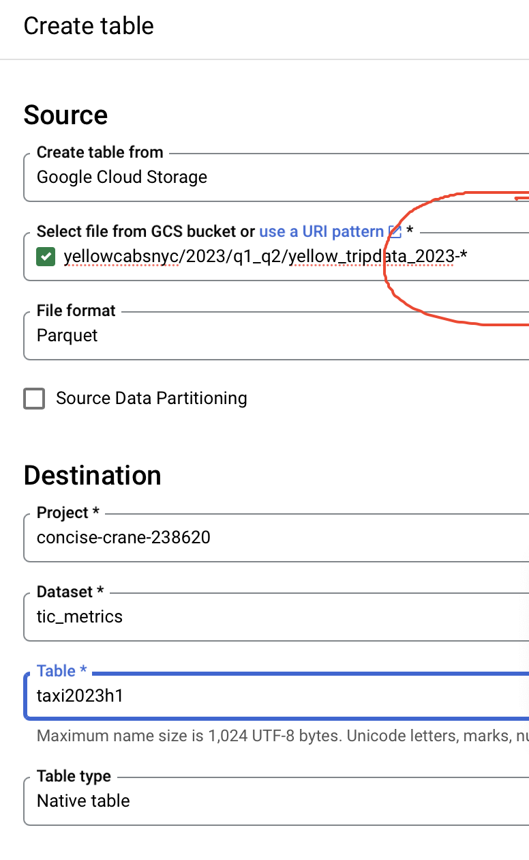

Slide 8
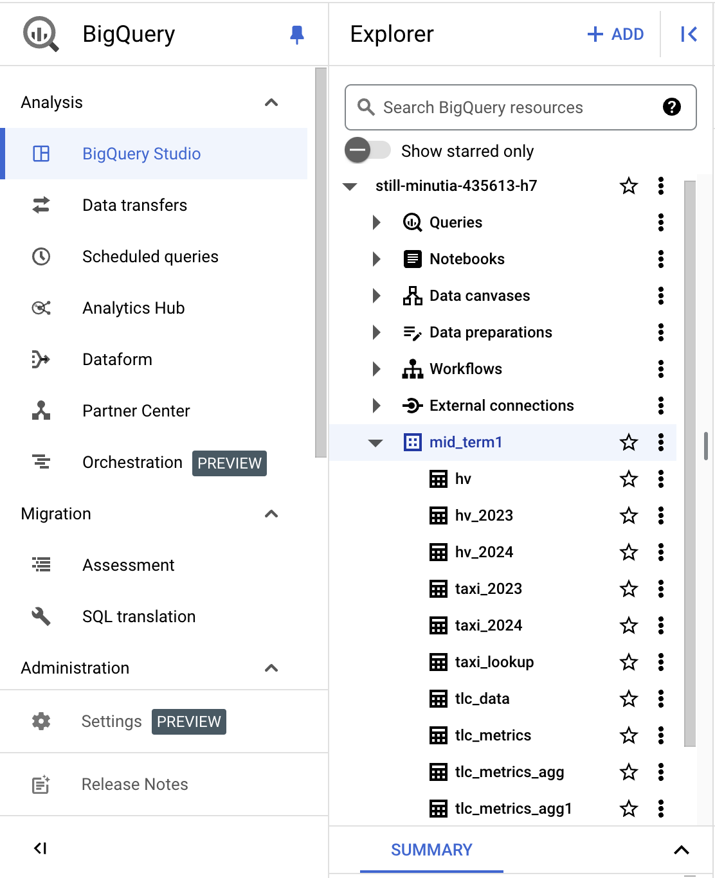
Data Mart 1 – Trip Metrics by Location and Time
Purpose: Analyze trip volume and distance by location and time.
Dimensions:
Pickup Borough
Drop-off Borough
Year
Month
Metrics:
Total Trips
Average Distance
Example Use Case: Identify peak demand times by borough.

Slide 9
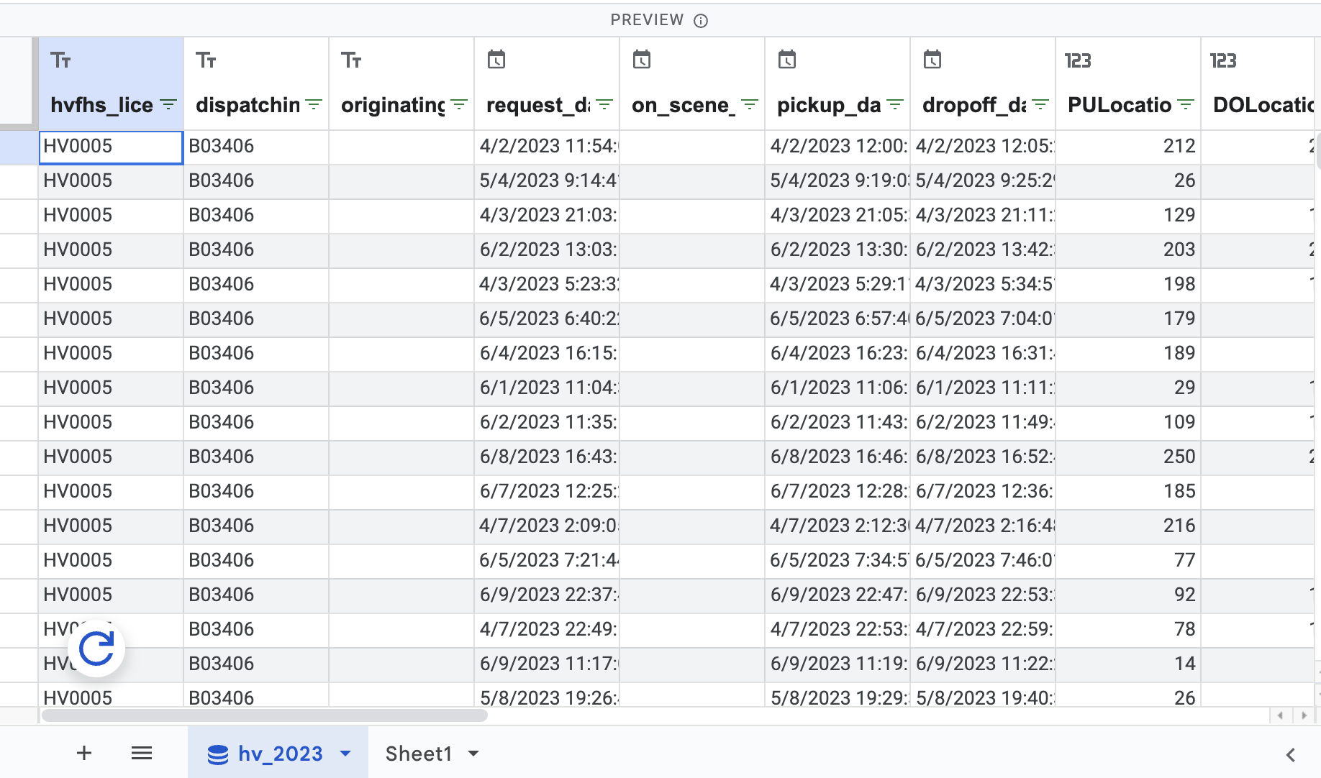

Slide 10
Data Mart 2 – Trip Patterns by Ride Type
Purpose: Compare Yellow Taxi, Uber, and Lyft performance.
Dimensions:
Ride Type (Taxi, Uber, Lyft)
Year
Quarter
Pickup/Drop-off Location
Metrics:
Total Trips
Average Distance
Example Use Case: Understand market share dynamics.

Slide 11
-- -- STEP 02: CREATE A FACT TABLE (CONTAINST THE DIMENSIONS AND METRICS)
-- create or replace table still-minutia-435613-h7.mid_term1.tlc_data as (
-- select 'taxi' as type ,extract(year from tpep_pickup_datetime) as year, extract(quarter from
-- tpep_pickup_datetime) as quarter, trip_distance as distance,PULocationID,DOLocationID
-- from still-minutia-435613-h7.mid_term1.taxi_2023
-- union all
-- select 'taxi' as type ,extract(year from tpep_pickup_datetime) as year, extract(quarter from tpep_pickup_datetime) as quarter, trip_distance as distance,PULocationID,DOLocationID
-- from still-minutia-435613-h7.mid_term1.taxi_2024
-- union all
-- select case when hvfhs_license_num='HV0005' then 'Lyft' when hvfhs_license_num='HV0003' then 'Uber' end as type , extract(year from pickup_datetime) as year, extract(quarter from pickup_datetime) as quarter, trip_miles as distance,PULocationID,DOLocationID
-- from still-minutia-435613-h7.mid_term1.hv_2023
-- union all
-- select case when hvfhs_license_num='HV0005' then 'Lyft' when hvfhs_license_num='HV0003' then 'Uber' end as type , extract(year from pickup_datetime) as year, extract(quarter from pickup_datetime) as quarter, trip_miles as distance,PULocationID,DOLocationID
-- from still-minutia-435613-h7.mid_term1.hv_2024);

Slide 12
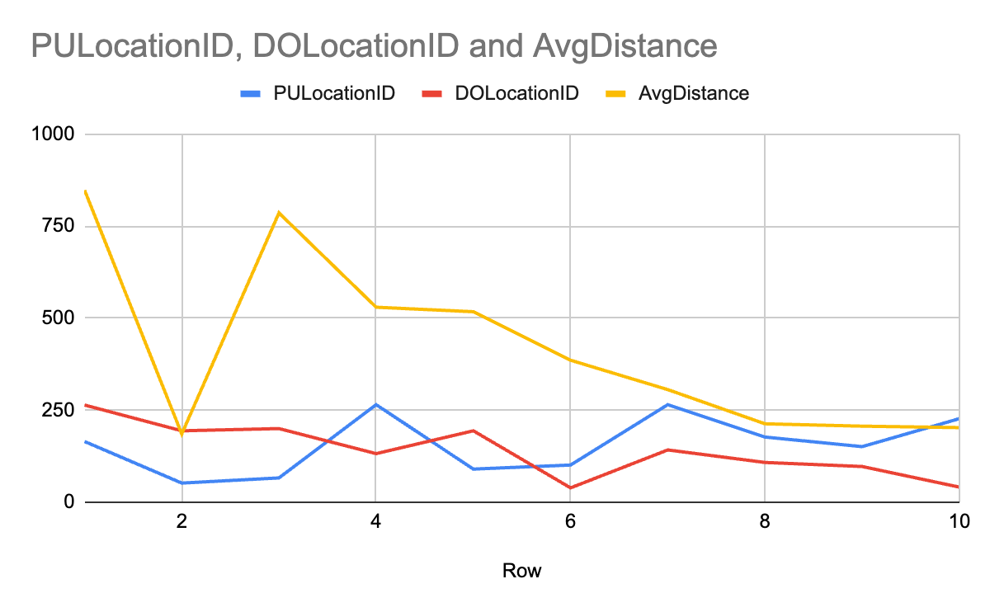
Row | year | month | trips | avg_distance | Rate of Change (trips) | Rate of Change (Avg. Distance)
1 | 2023 | 4 | 22433066 | 4.89
3 | 2023 | 5 | 23361340 | 5.03
2 | 2023 | 6 | 22673837 | 5.02
5 | 2024 | 4 | 23247331 | 5.07 | 3.63% | 3.68%
4 | 2024 | 5 | 24428381 | 5.18 | 4.57% | 2.98%
6 | 2024 | 6 | 23662381 | 5.18 | 4.36% | 3.19%
Row | PULocationID | DOLocationID | AvgDistance
1 | 165.0 | 264.0 | 848
2 | 52.0 | 194.0 | 185
3 | 66.0 | 200.0 | 786
4 | 265.0 | 132.0 | 530
5 | 90.0 | 194.0 | 517
6 | 101.0 | 39.0 | 386
7 | 265.0 | 142.0 | 306
8 | 177.0 | 108.0 | 213
9 | 151.0 | 97.0 | 207
10 | 227.0 | 41.0 | 203

Slide 13
Data Mining Model 1 – Multiple Linear Regression
Goal: Predict trip volume based on time, location, and ride type.
CRISP-DM Approach:
Business Understanding: Forecast demand to optimize resources.
Data Preparation: Clean data, encode boroughs, split into training/testing.
Modeling:
Dependent Variable: Trip Volume
Independent Variables: Time of Day, Day of Week, Pickup/Drop-off Borough, Ride Type.
Evaluation: Metrics like R², RMSE, and MAE.
Visualization: Feature importance bar chart, prediction vs. actual plot.

Slide 14
Data Mining Model 2 –
Goal: Group locations with similar trip characteristics.
CRISP-DM Approach:
Business Understanding: Identify clusters for targeted marketing or operational improvements.
Data Preparation: Use features like average distance, trip volume, borough.
Modeling:
Algorithm: K-Means Clustering
Features: Trip Volume, Average Distance, Borough.
Evaluation: Metrics like Silhouette Score and Inertia.
Visualization: Cluster map overlayed on NYC zones.

Slide 15
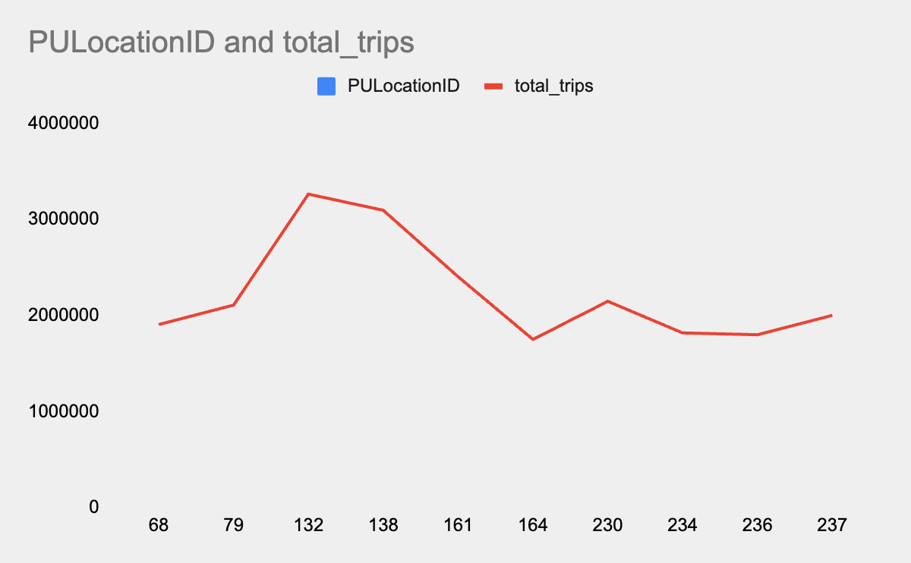
Top 10 trips by Pickup Location :
Row | PULocationID | total_trips
1 | 68 | 1905149
2 | 79 | 2107658
3 | 132 | 3263086
4 | 138 | 3095006
5 | 161 | 2403059
6 | 164 | 1750074
7 | 230 | 2147126
8 | 234 | 1818050
9 | 236 | 1799022
10 | 237 | 2000590

Slide 16
Visualizing the Results
Model 1 (Regression):
Feature Importance: Bar chart.
Predictions vs. Actual: Line chart for selected boroughs and times.
Model 2 (Clustering):
Cluster Heatmap: Show trip patterns by borough.
Map Visualization: Overlay clusters on NYC map.

Slide 17
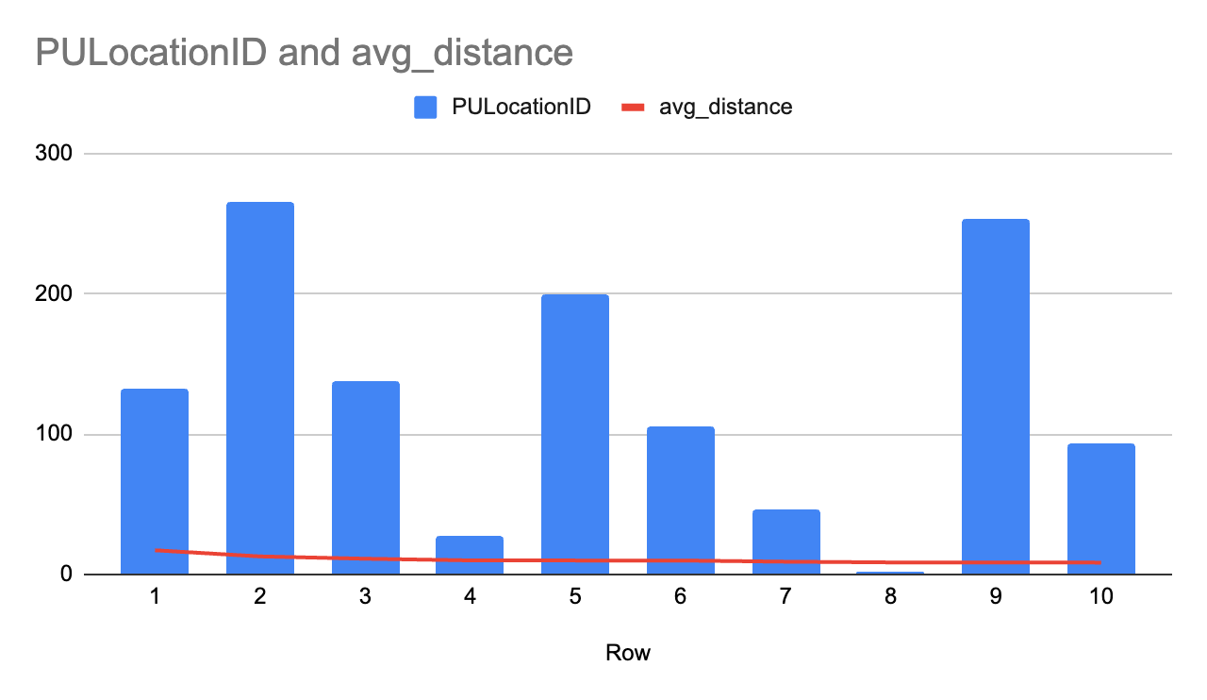
Top 10 Average Distances by Pick-Up Location
Row | PULocationID | avg_distance
1 | 132 | 17.21
2 | 265 | 12.84
3 | 138 | 11.18
4 | 27 | 10.01
5 | 199 | 9.93
6 | 105 | 9.91
7 | 46 | 9.08
8 | 2 | 8.56
9 | 253 | 8.56
10 | 93 | 8.41

Slide 18
Slide 10:
From Data Warehouse:
Yellow Taxis peak on weekdays; Uber/Lyft dominate weekends.
From Regression Model:
Time of day and ride type strongly predict trip volume.
From Cluster Analysis:
Boroughs grouped into high and low trip-volume clusters.

Slide 19
Next Steps
Refine models with additional data (e.g., weather, fares).
Automate predictions using BigQuery ML.
Expand the data warehouse with more historical data.

